Slide 1
CSE 4102 Computer Graphics and Image Processing Laboratory Week 2: Histogram Equalization
Md Tajmilur Rahman
Lecturer
Dept. of CSE, KUET
Md. Mubtashim Abrar Nihal
Lecturer
Dept. of CSE, KUET

Slide 2
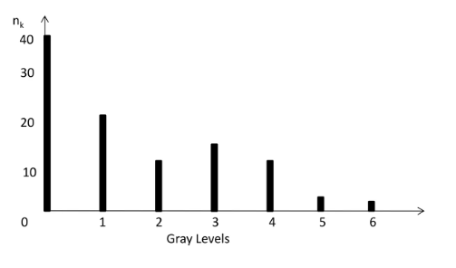

Histogram
The histogram of an image consists of the x-axis representing the intensity levels r_{k} and the y-axis denoting the h(r_{k}) or the p(r_{k}) functions.
$h(r_{k})=n_{k}$

Slide 3
Histogram Processing
A discrete function h(r_{k}) = n_{k}
Where r_{k} is the k^{th} intensity value and n_{k} is the number of pixels in the image with intensity r_{k}
Normalized histogram p(r_{k}) = n_{k}/MN
Where M and N are row and column dimensions of the image
Sum of all components of a normalized histogram is equal to 1

Slide 4
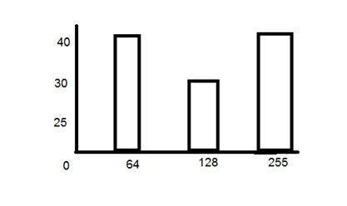
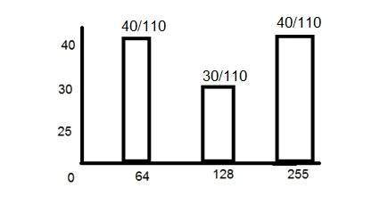


PDF
PDF stands for probability density function. It's a function where you can think of the x values as the range of possible occurring values and y values as their probability of occurrence.
$p\left(r_{k}\right)=\frac{n_{k}}{MN}$ $k=0,1,2……L−1$
$$n_{k}\text{: }\text{the number of pixels in the image of size M}×\text{N with intensity }r_{k}$$
$$n_{k}$$
PDF

Slide 5
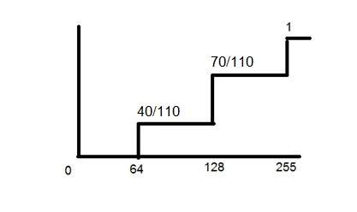
CDF
CDF holds the probability of a probability distribution less than or equal to a particular value.
It is a function that calculates the cumulative sum of all the values that are calculated by PDF.
PDF
CDF

Slide 6
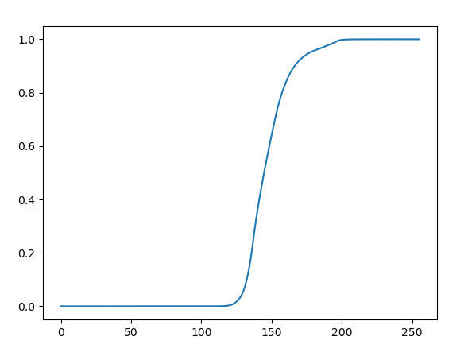
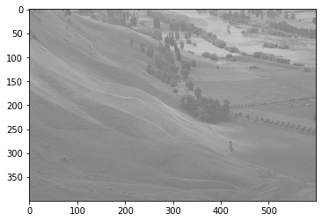
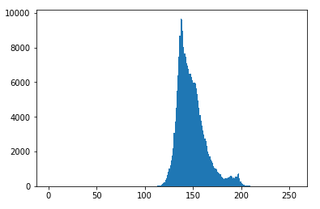
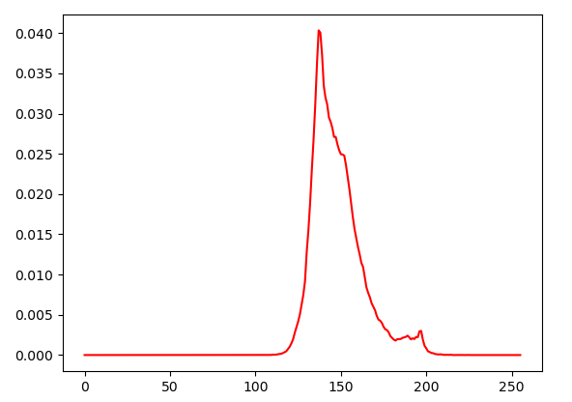
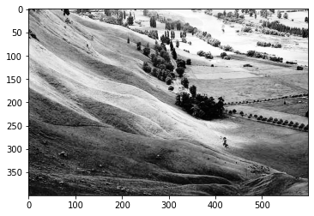
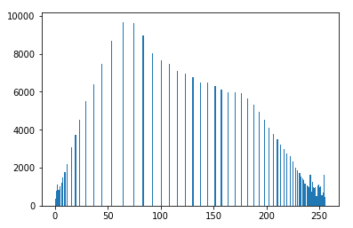
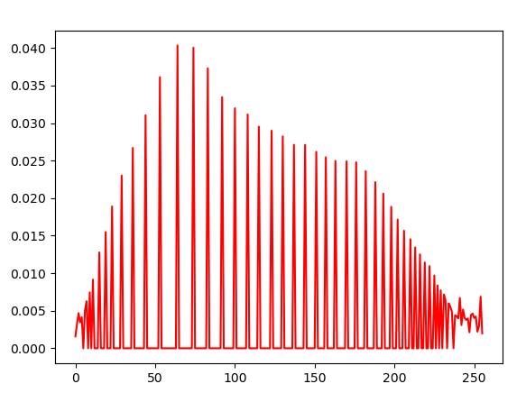
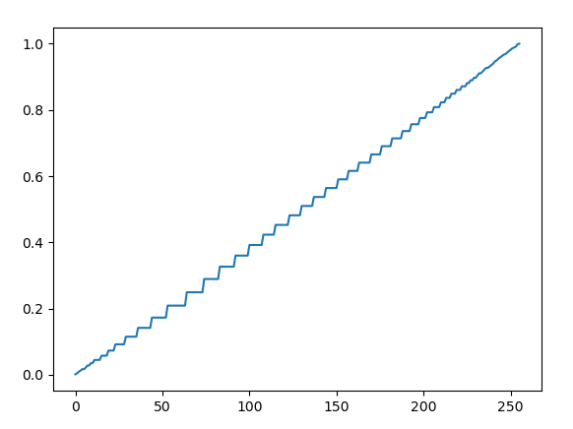
Histogram Equalization
Histogram equalization is used to enhance contrast.
Input Image
Histogram of the Input Image
PDF of the Input Image
CDF of the Input Image
Equalized Image
Histogram of the Equalized Image
PDF of the Equalized Image
CDF of the Equalized Image

Slide 7
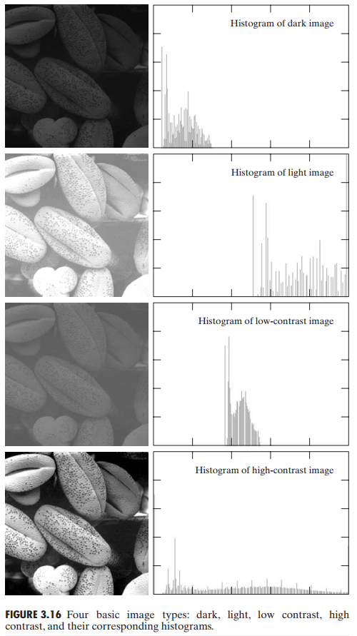
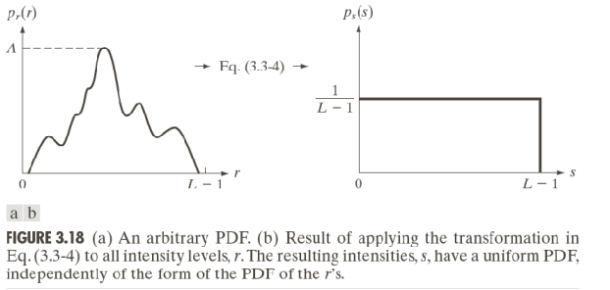
Effect of Histogram Processing

Slide 8
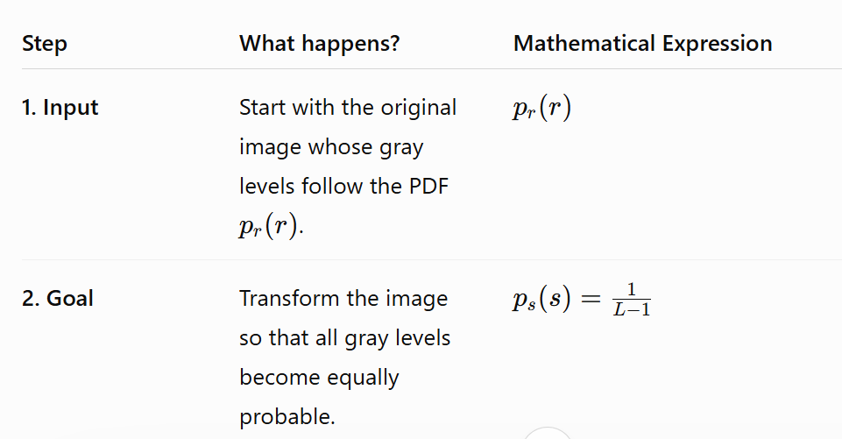

Our Goal

Slide 9
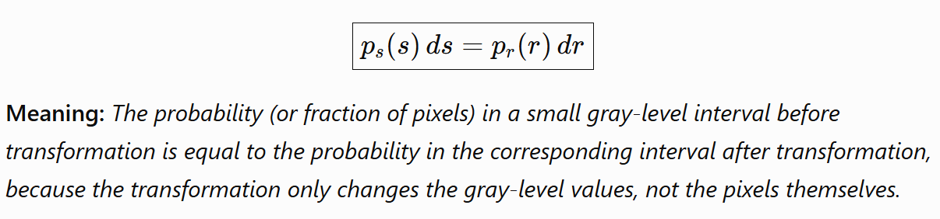
The Condition

Slide 10
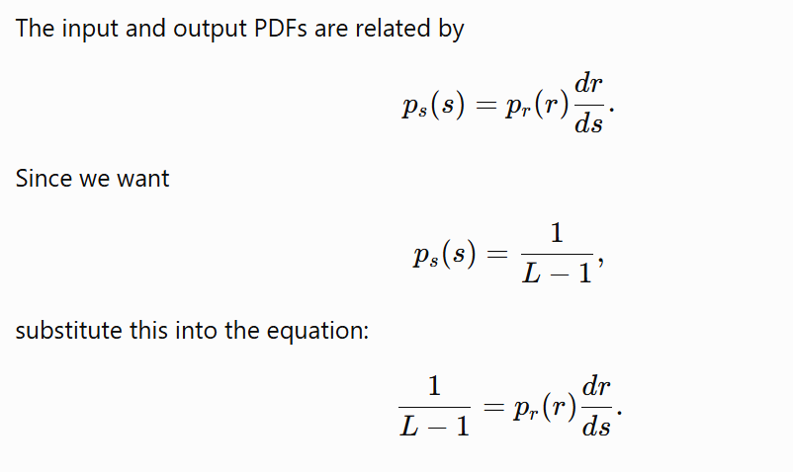
Find The Transformation Function

Slide 11
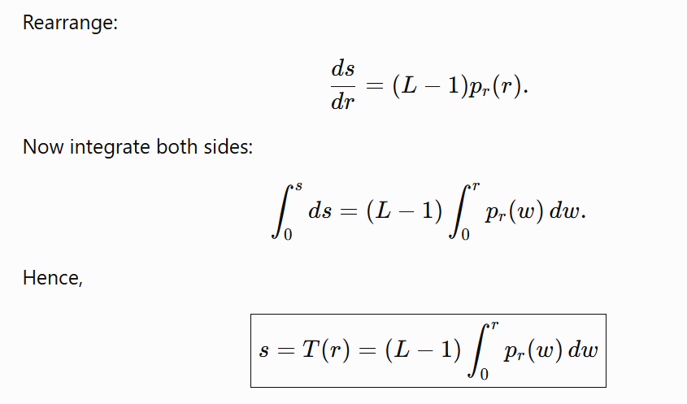
Find The Transformation Function

Slide 12
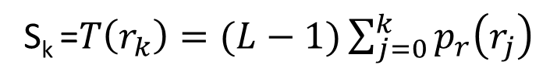
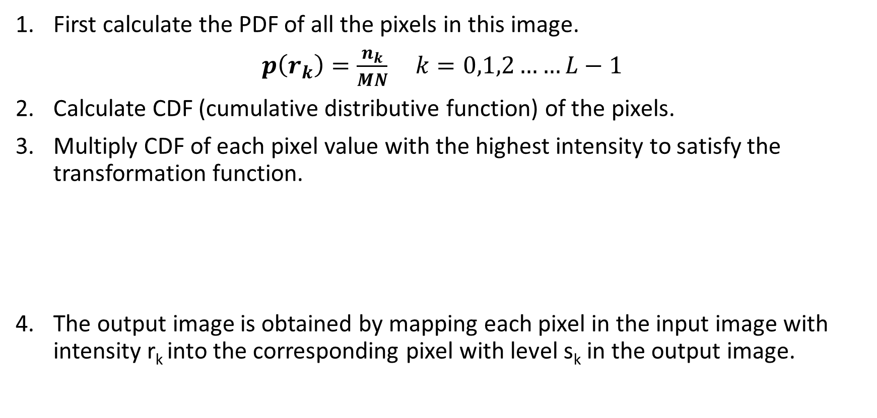
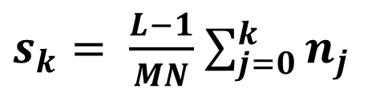
Histogram Equalization
First calculate the PDF of all the pixels in this image.
$p\left(r_{k}\right)=\frac{n_{k}}{MN}$ $k=0,1,2……L−1$
Calculate CDF (cumulative distributive function) of the pixels.
Multiply CDF of each pixel value with the highest intensity to satisfy the transformation function.
The output image is obtained by mapping each pixel in the input image with intensity r_{k} into the corresponding pixel with level s_{k} in the output image.
S_{k} =$T\left(r_{k}\right)=(L−1)\sum_{j=0}^{k}{p_{r}\left(r_{j}\right)}$
$s_{k}= \frac{L−1}{MN}$ $\sum_{j=0}^{k}{n_{j}}$

Slide 13
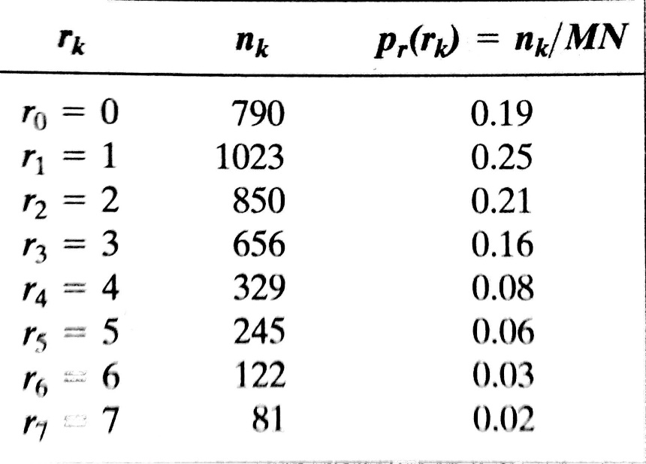
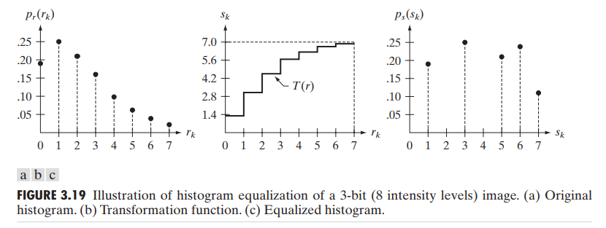
Map s_{k} to its r_{k}
s_{k}
S₀ = 1.33 = 1
S₁ = 3.08 = 3
S₂ = 4.55 = 5
S₃ = 5.67 = 6
S₄ = 6.23 = 6
S₅ = 6.65 = 7
S₆ = 6.86 = 7
S₇ = 7.00 = 7

Slide 14
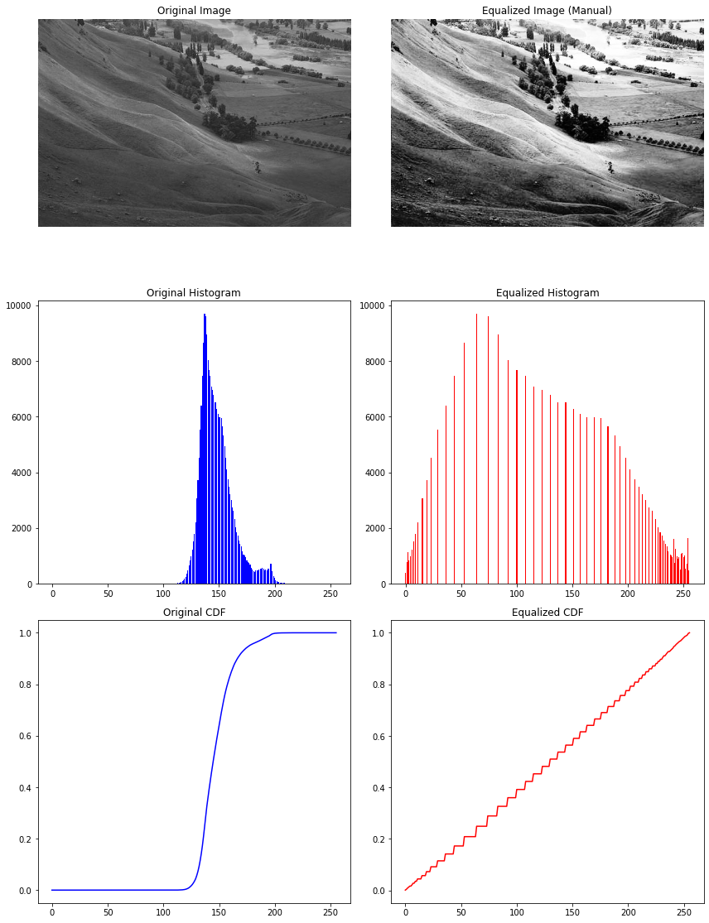
Class work

Slide 15
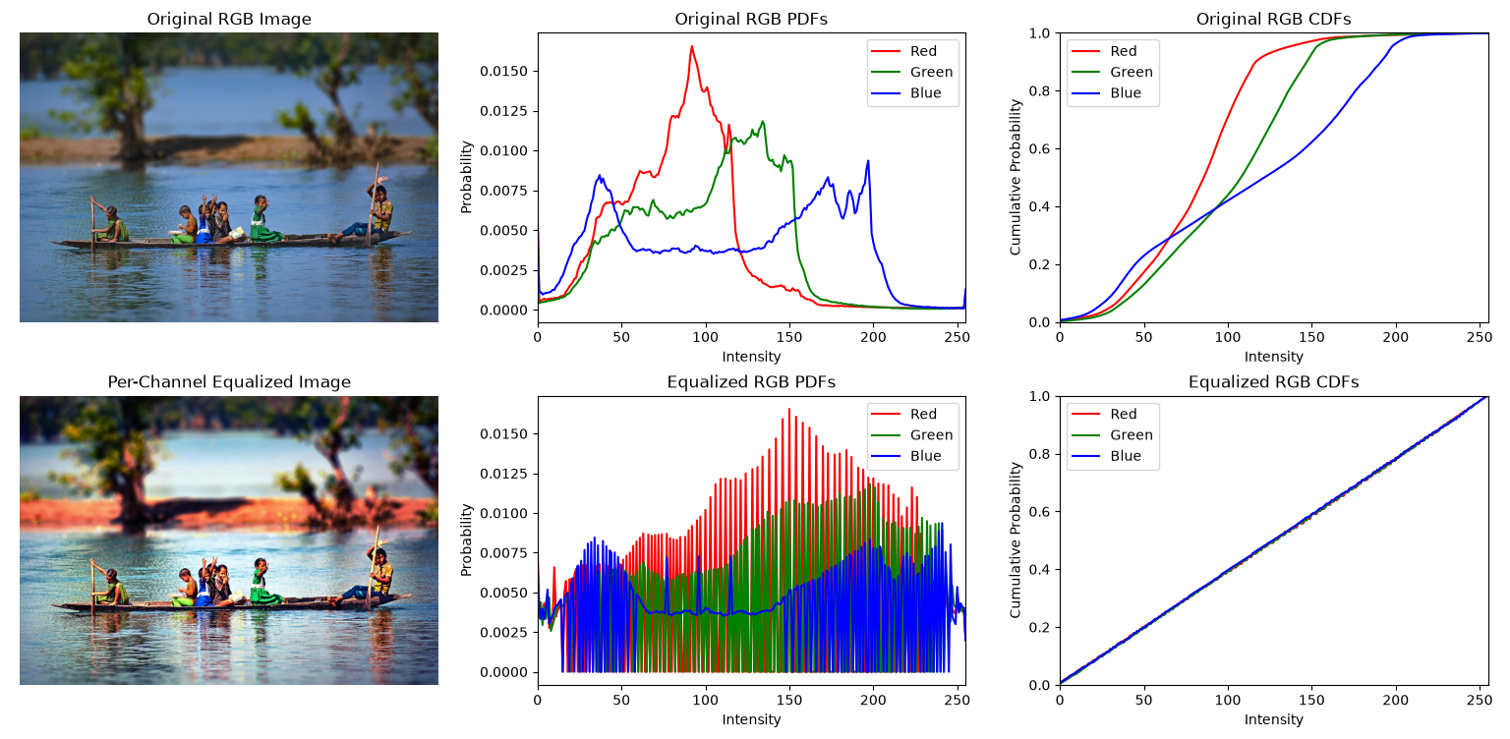
Home Work: Histogram Equalization (A1, B1)
Equalize an RGB image by individually equalizing all channels.

Slide 16
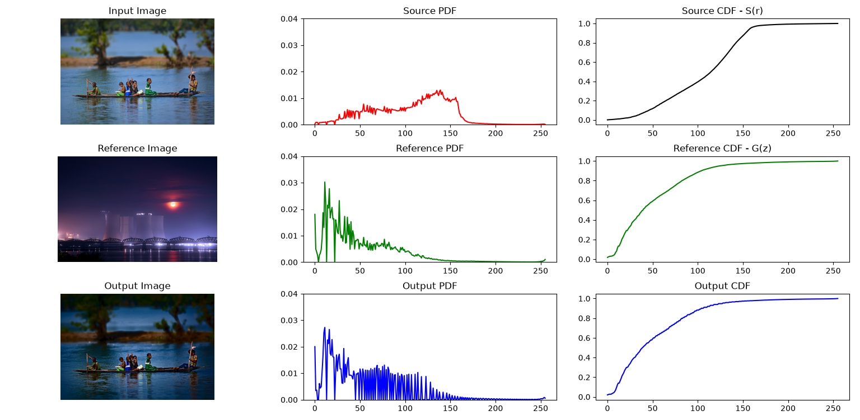
Home Work: Histogram Matching (A2, B2)
Equalize an RGB image by equalizing only the L channel in Lab color space.

Slide 17
Thank You

